Slide 1

WLMART SALES ANALYSIS
By Using SQL

Slide 2
INTRODUCTION
This project aims to analyze Walmart's sales data to gain insights into sales trends, identify top-performing branches and products, and understand customer behavior. By leveraging SQL queries, we can extract valuable information from the dataset and make data-driven decisions to optimize sales strategies.
Key Objectives:
Understand Sales Trends
Identify Top Performers
Customer Behavior Analysis

Slide 3
CONTENTS
HOW MANY UNIQUE PAYMENT METHOD DOES THE DATA HAVE ?
WHAT IS THE MOST COMMON METHOD OF PAYMENT ?
WHAT IS THE TOTAL REVENUE BY MONTH ?
REVENUE BY PRODUCT LINE
WHAT IS THE AVG RATING OF EACH PRODUCT LINE ?

Slide 4
CONTENTS
WHICH CITIES HAVE THE LARGEST TAX PERCENTAGE / VAT(VALUE ADDED TAX) ?
NUMBER OF SALES MADE IN EACH TIME OF THE DAY PER WEEKDAY ?
WHAT IS THE GENDER OF MOST OF THE CUSTOMER ?
WHICH TIME OF THE DAY DO CUSTOMERS GIVE MOST RATING ?
WHICH DAY OF THE WEEK HAS THE BEST AVG RATING ?

Slide 5


HOW MANY UNIQUE PAYMENT METHOD DOES THE DATA HAVE ?

Slide 6
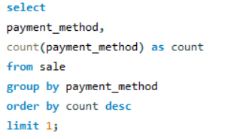

WHAT IS THE MOST COMMON METHOD OF PAYMENT ?

Slide 7
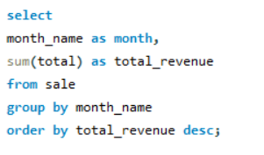
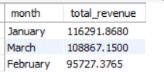
WHAT IS THE TOTAL REVENUE BY MONTH ?

Slide 8
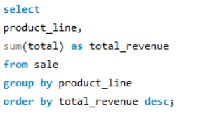
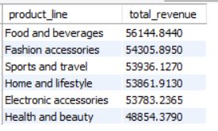
REVENUE BY PRODUCT LINE

Slide 9
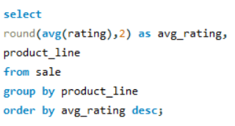
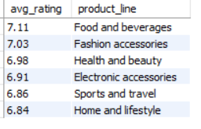
WHAT IS THE AVG RATING OF EACH PRODUCT LINE ?

Slide 10
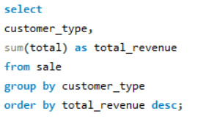

WHCIH OF THE CUSTOMER TYPES BRING THE MOST REVENUE?

Slide 11
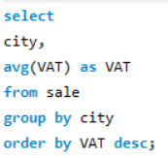

WHICH CITIES HAVE THE LARGEST TAX PERCENTAGE / VAT(VALUE ADDED TAX) ?

Slide 12
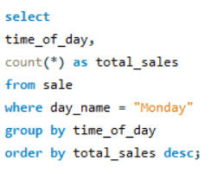

NUMBER OF SALES MADE IN EACH TIME OF THE DAY PER WEEKDAY ?

Slide 13
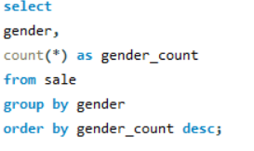

WHAT IS THE GENDER OF MOST OF THE CUSTOMER ?

Slide 14
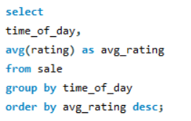
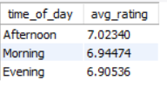
WHICH TIME OF THE DAY DO CUSTOMERS GIVE MOST RATING ?

Slide 15
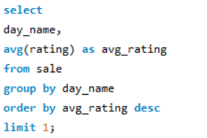

WHICH DAY OF THE WEEK HAS THE BEST AVG RATING ?

Slide 16
THANK YOU

